Slide 1

Peer Education Program for High School Youth Prevention of Substance Abuse doc.mehmet önemli rehabilitasyon psikolog

Slide 2

Studies conducted among high school students in Turkey reveal that the prevalence of substance use increases in general, although it varies according to regions and type of substance.

Slide 3

In studies on environmental risk factors leading to substance use, friend characteristics and friend influence come to the fore.

Slide 4

In other words, the friend effect affects both girls and women. increases the risk of substance use in men.

Slide 5

Peer Education (PE); young people are good with their peers based on the fact that they interact and identify with It is an educational activity developed based on social learning theory.

Slide 6
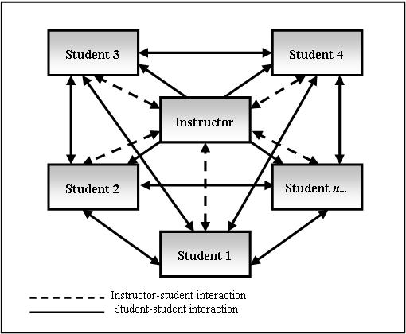
It is emphasized that information transfer is easier and more effective when young people who take an active role in peer education have a common background (music, social life, hobby etc.)

Slide 7

In our country, projects related to preventing risky behaviors in young people by using Peer Education method are carried out by international organizations such as UNICEF and UNFPA.

Slide 8

Yeşil Ay Association actively uses the peer education model to prevent substance addiction in Turkey.

Slide 9

Peer Education Program
The training program applied to the students in the experimental group was organized as 60-minute sessions, a total of thirteen sessions, and was implemented by the researchers.

Slide 10
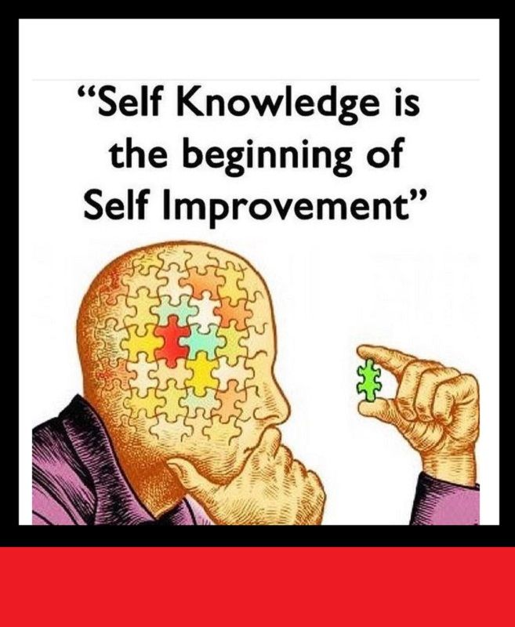
Session 1. Self-knowledge:
The goal of this session is to teach students how self-knowledge happens, the impact of definition on one's behavior, and to encourage students to reflect on themselves.

Slide 11

Session 2. Self-Confidence:
The purpose of this session is to inform students about what self-confidence is, how it is formed and how it can be increased.

Slide 12

Session 3. Communication:
The purpose of this session is to enable students to learn how to communicate effectively by developing their active listening and I-language skills.

Slide 13

Session 4: Coping with Anxiety:
The purpose of this session is to inform students about the symptoms of anxiety and to teach anxiety coping techniques.

Slide 14
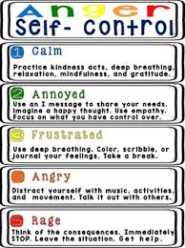
Session 5: Coping with anger:
The purpose of this session is to inform students about what anger is like and how it is expressed in positive and negative ways.

Slide 15

Session 6: Self-determination:
The purpose of this session is to inform students about shy, aggressive and safe behavior styles and to enable them to practice safe behavior.

Slide 16

Session 7: Saying “No”:
The purpose of this session is to develop students' ability to say no when faced with peer pressure or unwanted demands.

Slide 17

Session 8: Decision-Making:
The purpose of this session is to inform students about decision-making processes and methods so that they can make effective decisions on their own.

Slide 18

Session 9: Smoking:
The purpose of this session is to provide students with information about the harmful substances in cigarettes, the effects of smoking on health, and the reasons for smoking.

Slide 19

Session 10: Alcohol:
The purpose of this session is to inform students about the general characteristics and harms of alcohol.

Slide 20
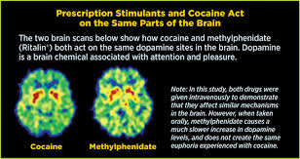
Session 11: Drugs and stimulants:
The purpose of this session is to inform students about the effects of drugs and stimulants on the brain.

Slide 21

Session 12: Addiction:
The purpose of this session is to inform students about addiction, the criteria for addiction, and the development of addiction.

Slide 22
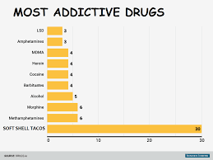
Session 13: Addictive substances quiz:
The purpose of this session is to increase and reinforce students' knowledge about addictive substances.

Slide 23

As a result,
after the implementation of the substance addiction prevention program, the level of knowledge of the students participating in this application and the substance use It is seen that their rejection skills increase and their false beliefs about drugs decrease.

